Slide 1
15.1 Connecting Devices
Five connecting devices
  Repeaters
  Hubs
  Bridges
  Switches
  Routers
  Gateway

Slide 2

Figure 15.1 Five categories of connecting devices

Slide 3
Repeaters
A physical layer device the acts on bits not on frames or packets
Can have two or more interfaces
When a bit (0,1) arrives, the repeater receives it and regenerates it, the transmits it onto all other interfaces
Used in LAN to connect cable segments and extend the maximum cable length ➔ extending the geographical LAN range
  Ethernet 10base5 – Max. segment length 500m – 4 repeaters (5 segments) are used to extend the cable to 2500m)
  Ethernet 10Base2- Max. segment length 185m - 4 repeaters (5 segments) are used to extend the cable to 925m
Repeaters do not implement any access method
  If any two nodes on any two connected segments transmit at the same time collision will happen

Slide 4

Figure 15.3 Function of a repeater

Slide 5

Figure 15.2 A repeater connecting two segments of a LAN

Slide 6
Hubs
Acts on the physical layer
Operate on bits rather than frames
Also called multiport repeater
Used to connect stations adapters in a physical star topology but logically bus
Connection to the hub consists of two pairs of twisted pair wire one for transmission and the other for receiving.
Hub receives a bit from an adapter and sends it to all the other adapters without implementing any access method.
does not do filtering (forward a frame into a specific destination or drop it) just it copy the received frame onto all other links
The entire hub forms a single collision domain, and a single Broadcast domain
  Collision domain: is that part of the network (set of NICs) when two or more nodes transmit at the same time collision will happen.
  Broadcast domain: is that part of the network (set of NIC) where each NIC can 'see' other NICs' traffic broadcast messages.
Multiple Hubs can be used to extend the network length
For 10BaseT and 100BaseT the maximum length of the connection between an adapter and the hub is 100 meters ➔ the maximum length between any two nodes is 200 m = maximum network length

Slide 7
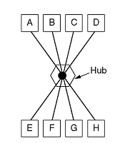
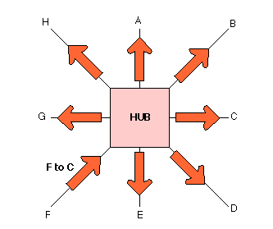
Figure 16.4 Hubs

Slide 8

Interconnecting with hubs
Backbone hub interconnects LAN segments
Advantage:
  Extends max distance between nodes
Disadvantages
  Individual segment collision domains become one large collision domain ➔ (reduce the performance)
  Can’t interconnect different Ethernet technologies(like 10BaseT & 100BaseT) because no buffering at the hub
Here we have a single collision domain and a single broadcast domain

Slide 9
Hubs Vs. Repeaters
Hub are different than repeaters in the following:
  The provide network management features by gathering information about the network and report them to a monitoring host connected to the hub so some statistics about the network (bandwidth usages, collision rates, average frame sizes) can be generated.
  If an adapter is not working the hub can disconnect it internally and the network will not be affected.

Slide 10

Bridges/switches
Acts on the data link layer (MAC address level)
Used to divide (segment) the LAN into smaller LANs segments, or to connect LANs that use identical physical and data link layers protocol (see figure in next slide)
Each LAN segment is a separate collision domain
Bridge does not send the received frame to all other interfaces like hubs and repeaters, but it performs filtering which means:
  Whether a frame should be forwarded to another interface that leads to the destination or dropped
This is done by a bridge table (forwarding table) that contains entries for the nodes on the LAN
  The bridge table is initially empty and filled automatically by learning from frames movements in the network
  An entry in the bridge table consists of : Node LAN (MAC) Address, Bridge Interface to which the node is connected to, the record creation time
A bridge runs CSMA/CD before sending a frame onto the link not like the hub or repeater
Bridge frame handling is done in software

Slide 11
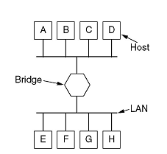
Bridges
Connecting two or more LAN segments together

Slide 12
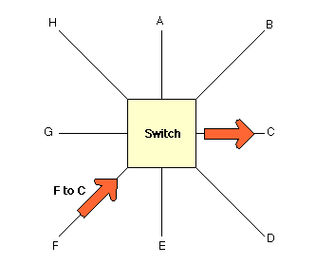
Bridges (Switches) Vs. Hubs
A Hub sending a packet form F to C.
A Switch sending a packet from F to C

Slide 13

Figure 15.5 A bridge connecting two LANs

Slide 14
Switch learning process
When the switch receives a frame, it compares the source address of the frame with each entry in the forwarding table
  If No match is found, the bridge will add to the table the frame source address and the Interface on which the frame was received.
  If a match is found, the bridge updates the Interface number on which the frame was received if it is different from the one in the table also it updates the record time
Then, the switch compares the destination address of the frame with each entry in the forwarding table (MAC table)
  If a match is found then
    The bridge compares the interface number on which the frame was received and the interface number in the table, if they are different the bridge forwards the frame through the interface number stored in the table. Otherwise, if they are the same the switches discards (drops) the frame.
  If no match is found, the switch floods the frame on all interfaces except the one on which the frame was received.

Slide 15

Figure 15.6 A learning switch and the process of learning
Read Page 449

Slide 16
Some switch features
Implements CSMA/CD
switches Isolates collision domains (each LAN segment is a separate collision domain), THIS WILL REDUCE THE POSSIBILITY OF COLLISIONS AND result in higher total max throughput (see next slide)
switch forwards a frame with broadcast address to all devices attached to the whole network (single broadcast domain)
Can be used to combine Ethernet segments using different Ethernet technologies (10Base2 and 100BaseT and 10BaseT) because it has buffering capabilities
Increases reliability (how?), performance (how?), and security (how?)
Increases geographical coverage
  No limit on the size of the LANs connected through switches
Transparent: installing or removing a switch does not require the stations networking software to be reconfigured.
(“plug-and-play”): no configuration necessary at installation of switch /switch or when a host is removed from one of the LAN segments
Disadvantage: switch does not allow multiple paths between LAN segments or between any two devices.

Slide 17

Figure 13.14 Sharing bandwidth

Slide 18
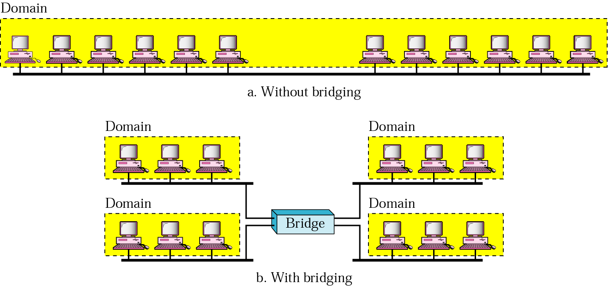
Collision domains in a nonbridged and bridged network
In heavy load, each station has an average effective theoretical bandwidth = 10/12
Each station has an average effective bandwidth equal =10/3

Slide 19
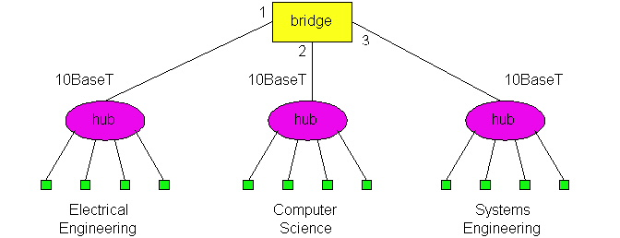
Switch
Example:
  Three LANs connected through a bridge
  Note: here we have three collision domains and a single broadcast domain

Slide 20
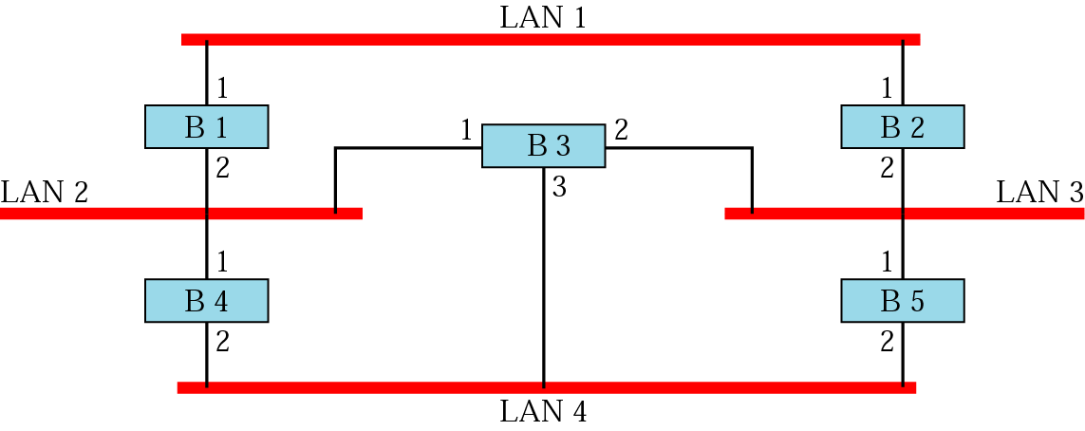
Figure 16.8 Prior to spanning tree application
Switch
When using switches, the network should not contain any loop (there should be exactly one path from any LAN to any other LAN
Loops can cause number of frames in the LAN to increase indefinitely

Slide 21
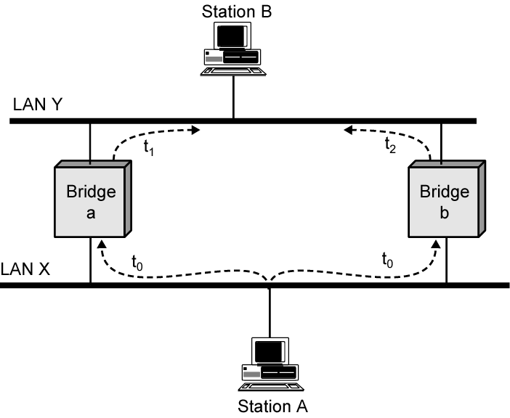
Effect of Loop of switches

Slide 22
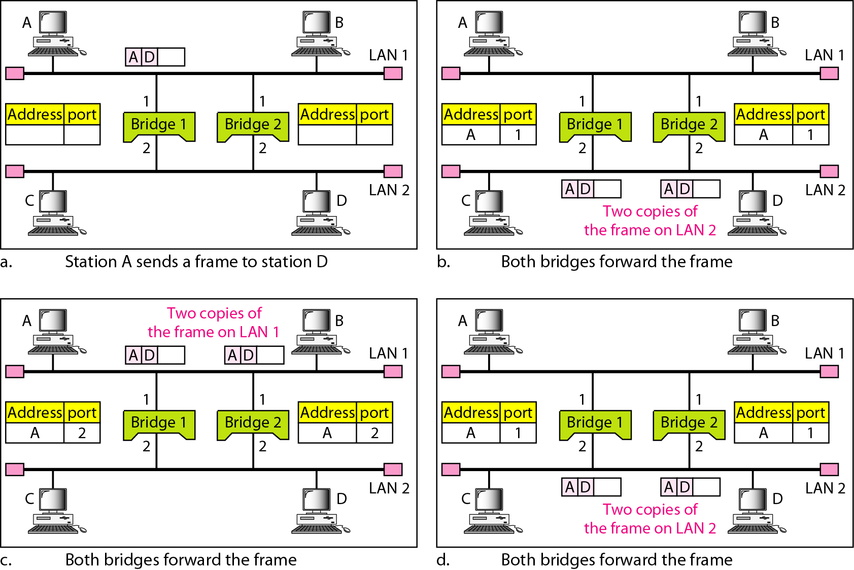
Figure 15.7 Loop problem in a learning switch

Slide 23
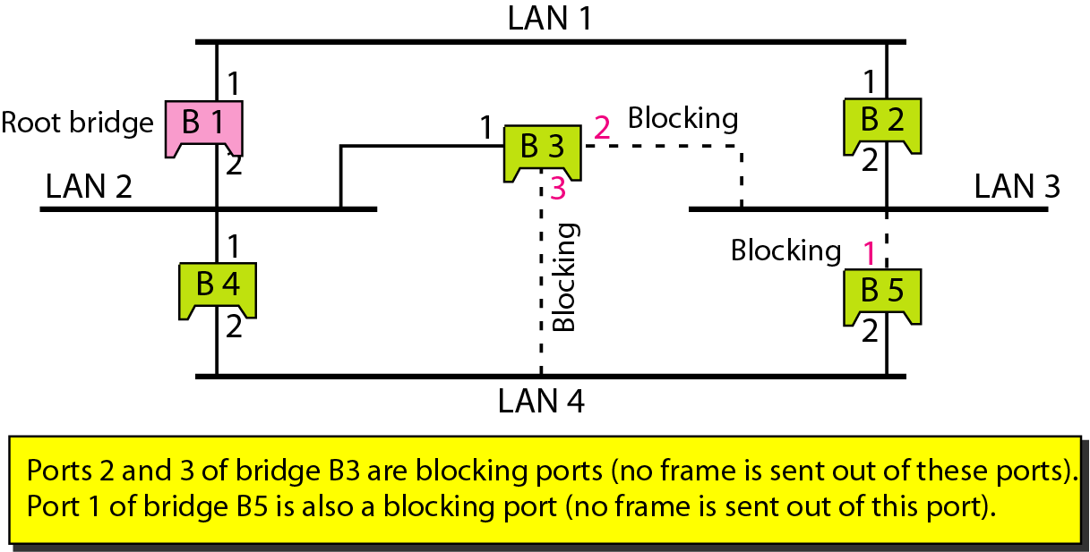
Figure 15.10 Forwarding and blocking ports after using spanning
tree algorithm
For any connected graph there is a spanning tree that maintains connectivity but contains no closed loops
Loops are logically disabled by the minimum spanning tree algorithm

Slide 24
Switches
N-Port bridge where N is equal to number of stations
Usually used to connect individual computers not LANs like bridge
Allows more than one device connected to the switch directly to transmit simultaneously
Can operates in Full-duplex mode (can send and receive frames at the same time over the same interface)
Performs MAC address recognition and frame forwarding in hardware (bridge in software)
Two types :
  Store-and-forward: switch receives the whole a frame on the input line, buffers it briefly , performs error checking, then routes it to the appropriate output line (similar to bridge). Buffering will cause some delay.
  Cut-through: based on the fact that the destination address appears at the beginning of the MAC frame, so once the address is recognized the frame is directly sent to the appropriate output line if the output buffer is empty (no need to buffer it). ➔ no buffering delay ➔ NO ERROR CHECKING

Slide 25
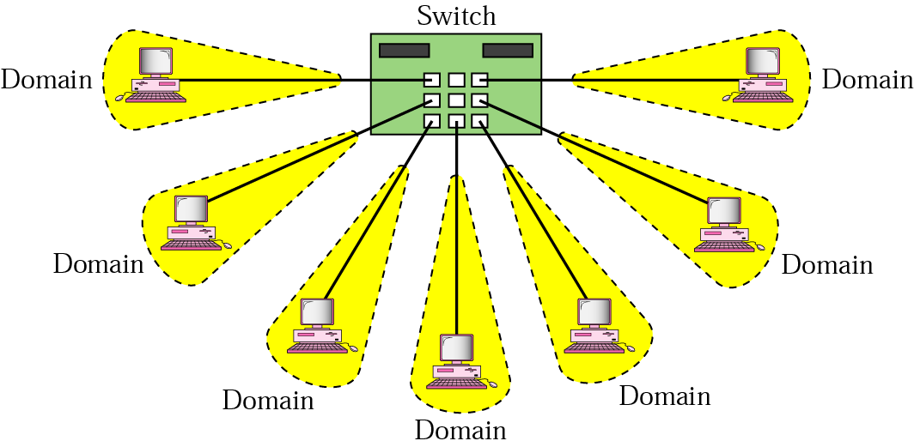
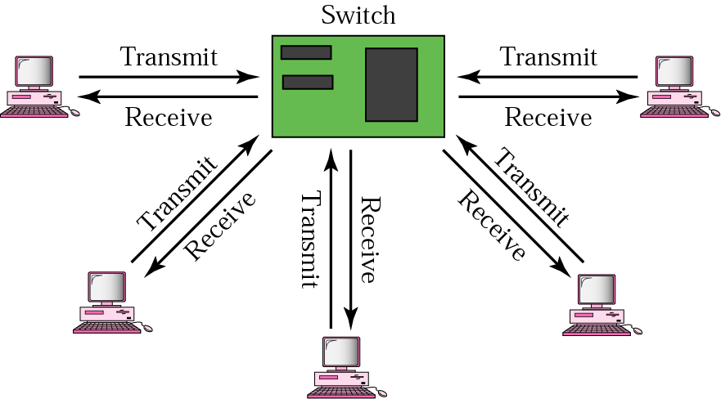
Isolated collision domains
Full-Duplex operation

Slide 26
Routers
  Operates at network layer = deals with packets not frames
  Connect LANs and WANs with similar or different protocols together
  Switches and bridges isolate collision domains but forward broadcast messages to all LANs connected to them. Routers isolate both collision domains and broadcast domains
  Acts like normal stations on a network, but have more than one network address (an address to each connected network)
  Deals with global address ( network layer address (IP)) not local address (MAC address)
  Routers Communicate with each other and exchange routing information
  Determine best route using routing algorithm by special software installed on them
  Forward traffic if information on destination is available otherwise discard it (not like a switch or bridge)

Slide 27

Figure 15.11 Routers connecting independent LANs and WANs
Routers

Slide 28
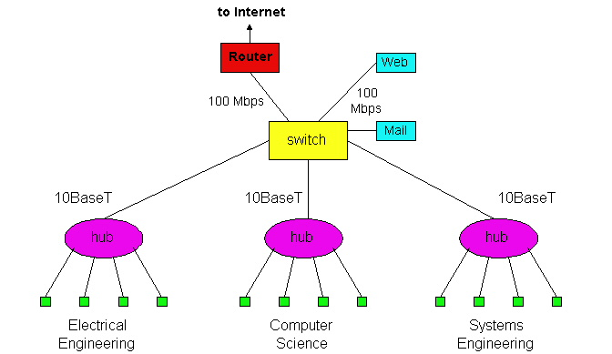
An Institutional Network Using Hubs, Ethernet Switches, and a Router

Slide 29
switch
switch
switch

Slide 30
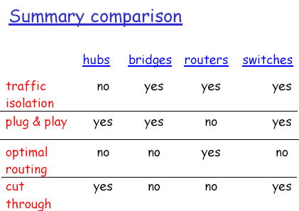

Slide 31
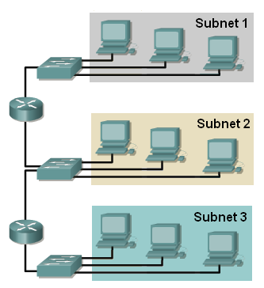
15.3 Virtual LANs
3 Collision domains
3 Broadcast domains
If we want to move computers from group1 to group3, then rewiring (physical replacement) has to be done
What is the alternative solution??
VLAN: Virtual (logical) Local Area Network : Local Area Network configured by software not by physical wiring

Slide 32
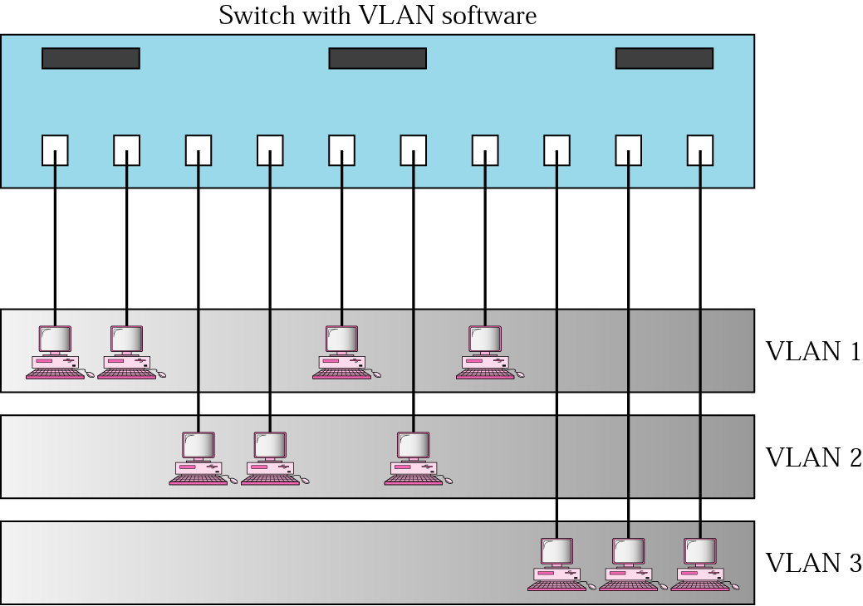
Figure 16.15 A switch using VLAN software
VLAN1: Ports 1,2,5,7
VLAN2: Ports 3,4,6
VLAN3: Ports 8,9,10
1
2
3
4
5
6
7
8
9
10
Separate broadcast domain ➔ separate network
Using the Virtual LAN technology will allow grouping computers logically instead of physically.
VLAN divides the physical LAN into several Logical LANs called VLANs
Switch maintains a look up table to know to which LAN a machine belongs to.

Slide 33

Figure 15.17 Two switches in a backbone using VLAN software

Slide 34

Note:
VLANs create broadcast domains.

Slide 35
Advantages Of VLAN
Reduce cost and installation time:
  Instead of physically moving a station to another segment or another switch, it can be moved by software.
Increase security:
  A group of users needing a high security can be put into a VLAN so that NO users outside the VLAN can communicate with them.
  Stations belong to the same group can send broadcast messages that will NOT be received by users in others VLAN groups
Creating Virtual Workgroups
  Stations located at physically different locations can be added easily to the same broadcast domain so that they can send broadcast messages to one another.
    EXAMPLE: people from different departments working on the same project

